Slide 1
Week 4 PF

Slide 2
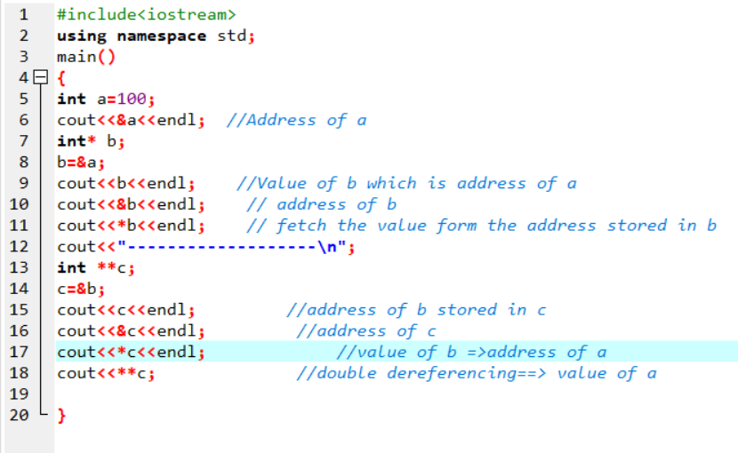

Slide 3
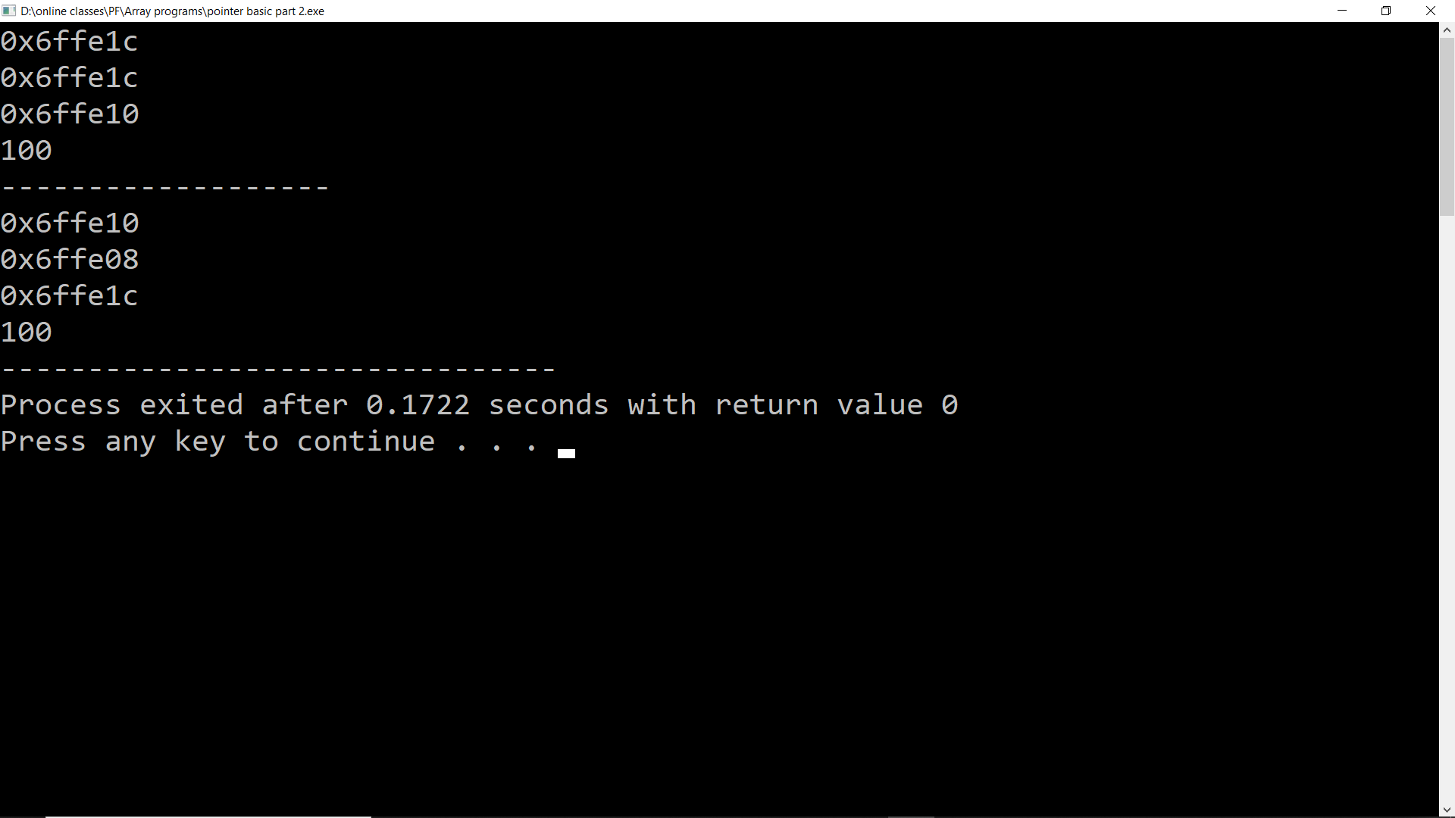

Slide 4
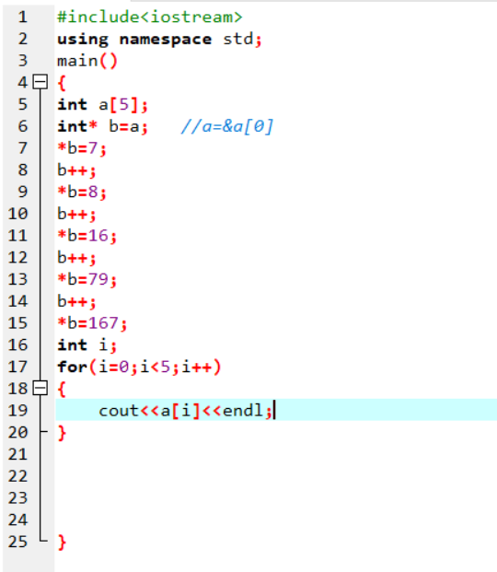

Slide 5
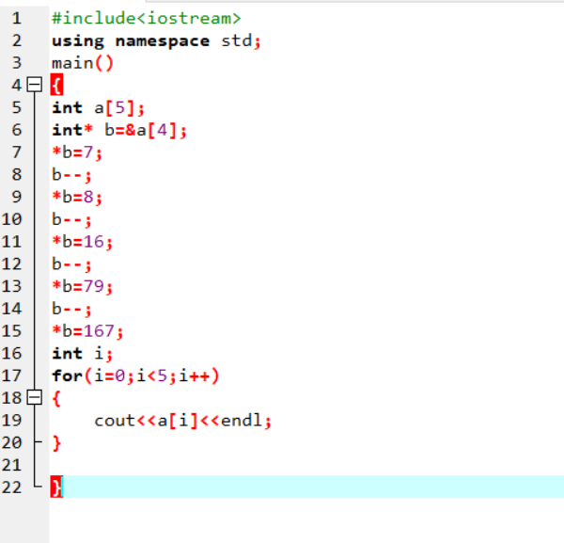

Slide 6
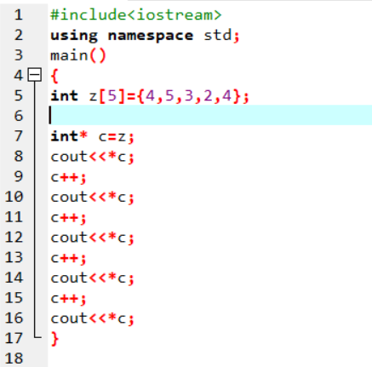

Slide 7
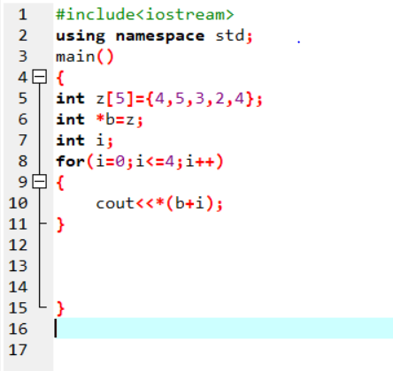

Slide 8
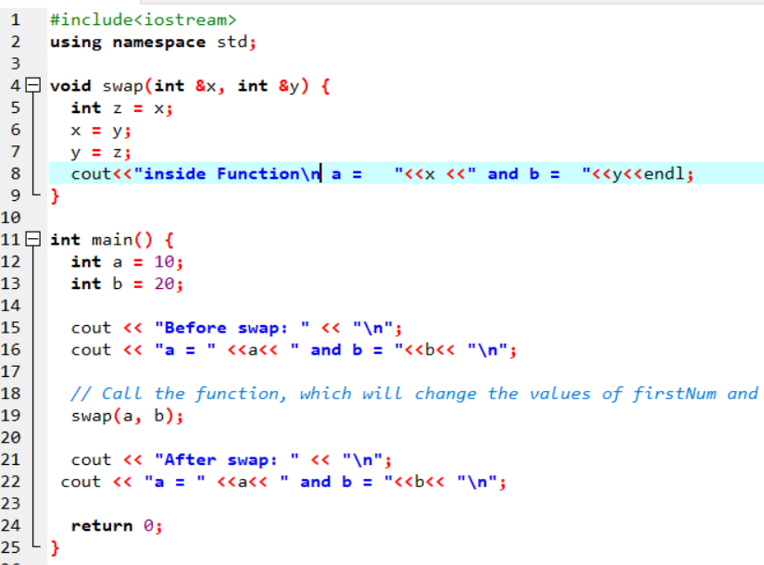
PASS BY REFERENCE:
Pass by reference (also called pass by address) means to pass the reference of an argument in the calling function to the corresponding formal parameter of the called function so that a copy of the address of the actual parameter is made in memory,

Slide 9
Function Overloading
Two or more functions having same name but different argument(s) are known as overloaded functions.
In C++ programming, two functions can have same name if number and/or type of arguments passed are different.
These functions having different number or type (or both) of parameters are known as overloaded functions. For example:
int test() { }
int test(int a) { }
float test(double a) { }
int test(int a, double b) { }

Slide 10
Function Overloading
The number and type of arguments passed to these two functions are same even though the return type is different. Hence, the compiler will throw error.
int test(int a) { }
double test(int b){ }

Slide 11
